Slide 1


Citi QA Q3 Report
Notes:
current colors

Slide 2
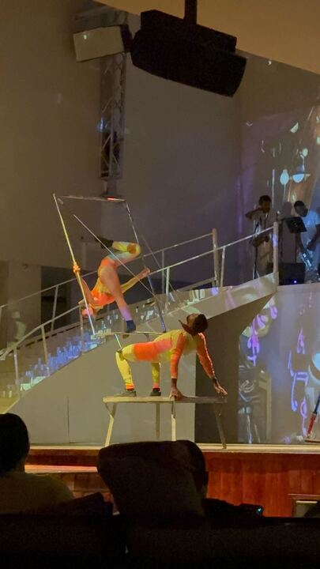

About Me!
Neil Jones
QA Analyst
POSITION
Winston-Salem, NC
LOCATION
🍿🏋🏻‍♂️🎳🎮
HOBBIES
Notes:
For emojis you can copy/paste to use in this slide, go here: https://getemoji.com/. Copy/paste the emojis you want and change the size by highlighting the emojis and adjusting the font size.

Slide 3
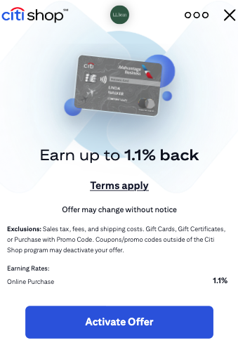
What does QA mean for WF?
Quality Assurance for WF is ensuring that the user is able to have a seamless shopping experience.
From when the user sees the Offer wall, to activating the offer, and validating there are no mishaps through the process.

Slide 4
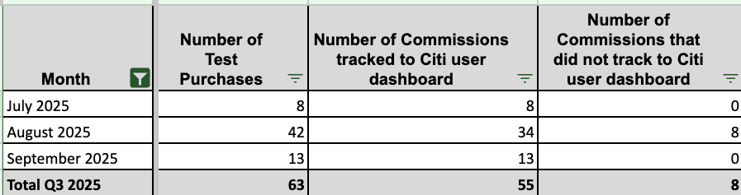
CITI Q3 Test Purchases
Notes:
Update merchant picture

Slide 5
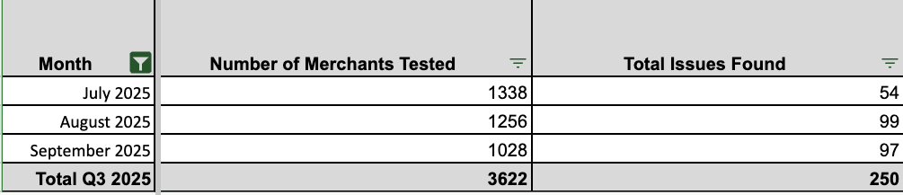
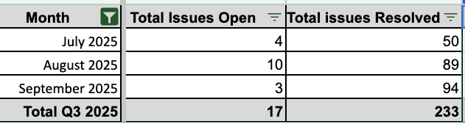
EMA Testing
Recap

Slide 6
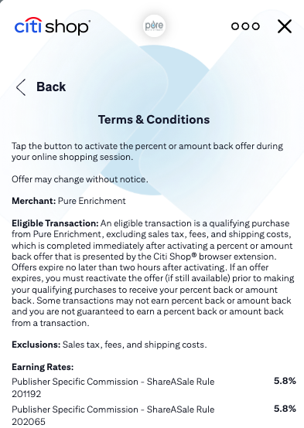
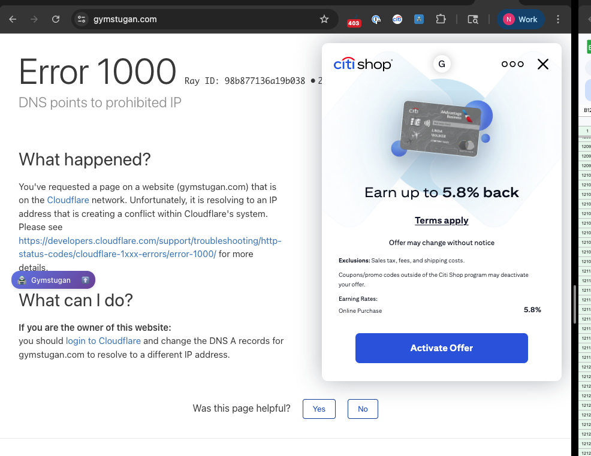
Q3 Findings
Merchants were still live in Citi, but the merchants had went out of business.
SaS migration to Awin merchants returning “This link is not active” when activating offer.
Links being updated/changed and needing to be added to Citi feeds.
Messy/confusing rates needing to be cleaned up.

Slide 7
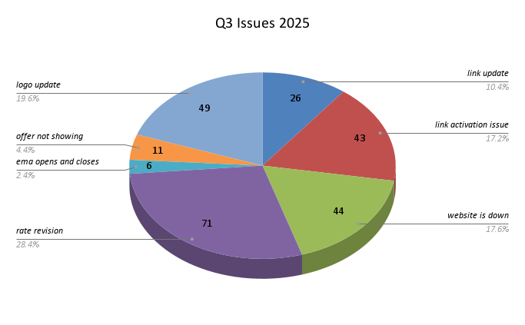
In-depth Chart
Notes:
Compare what was found in Q2 vs Q3 in new issues

Slide 8
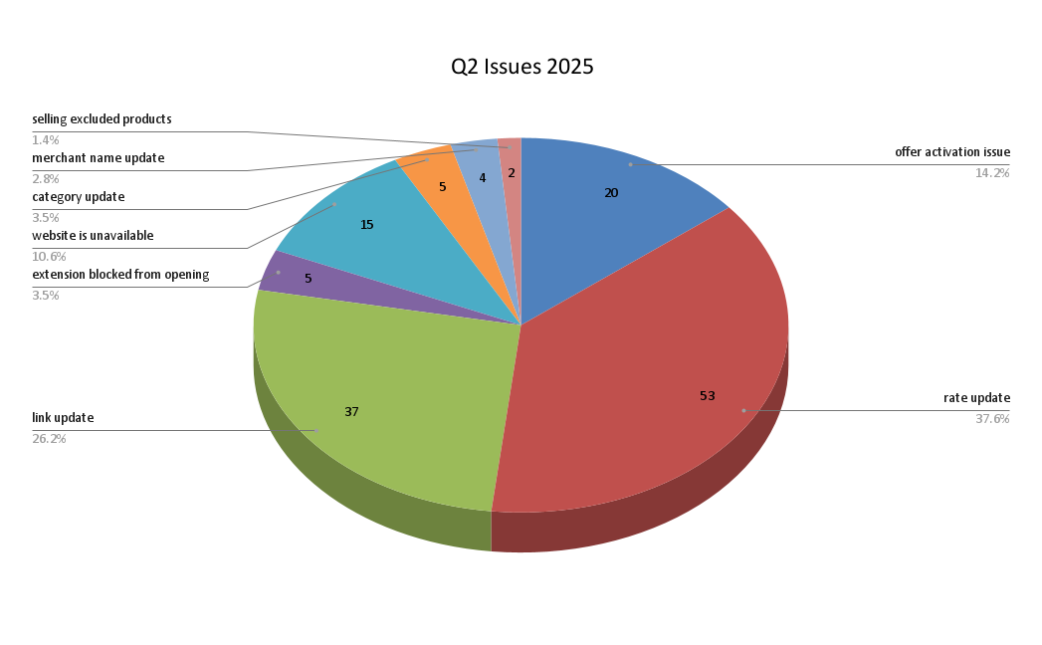

Slide 9
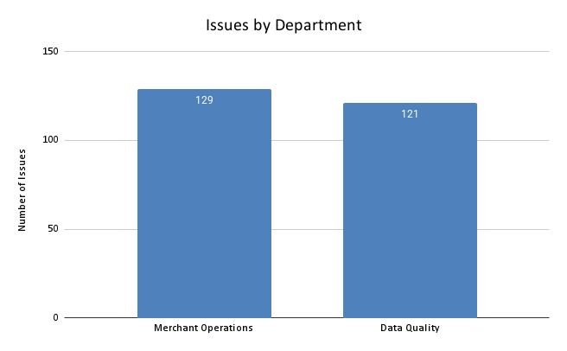

Slide 10
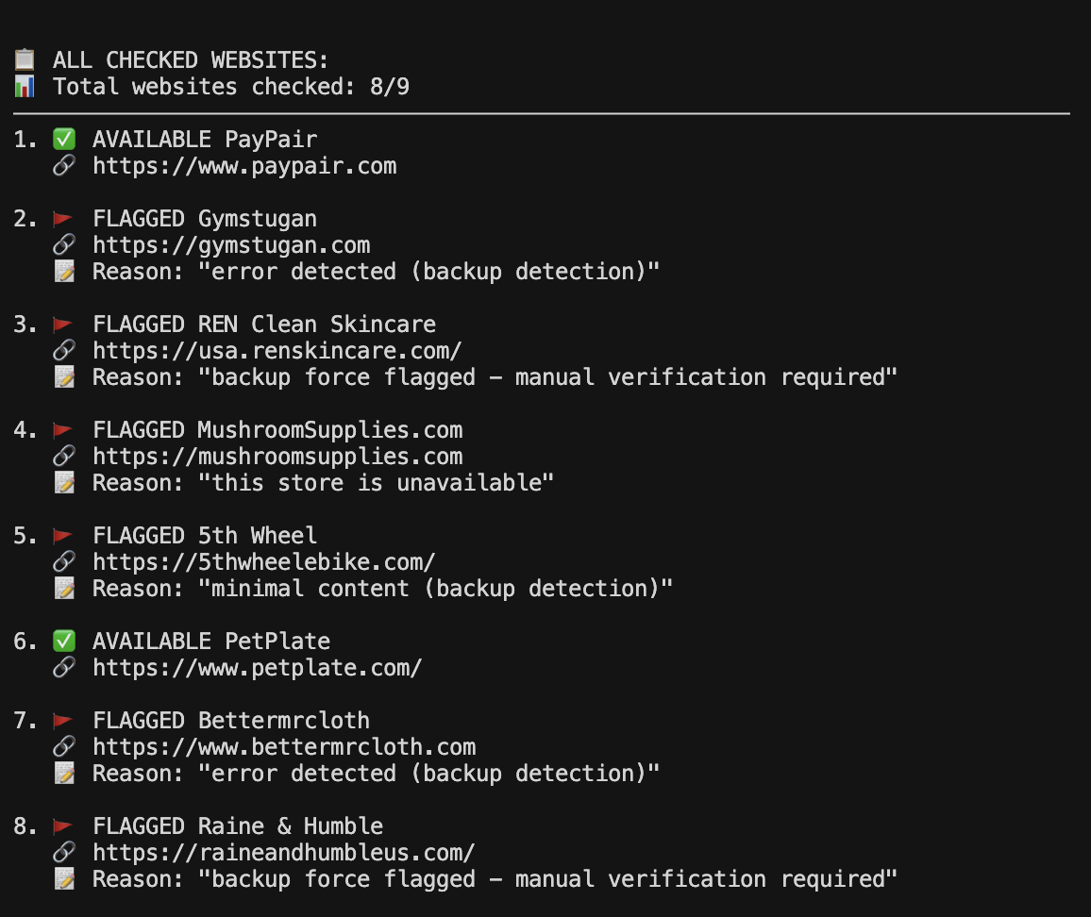
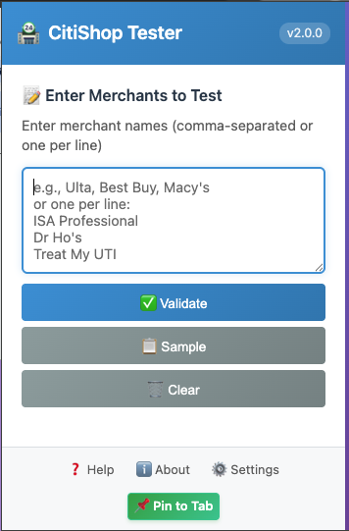
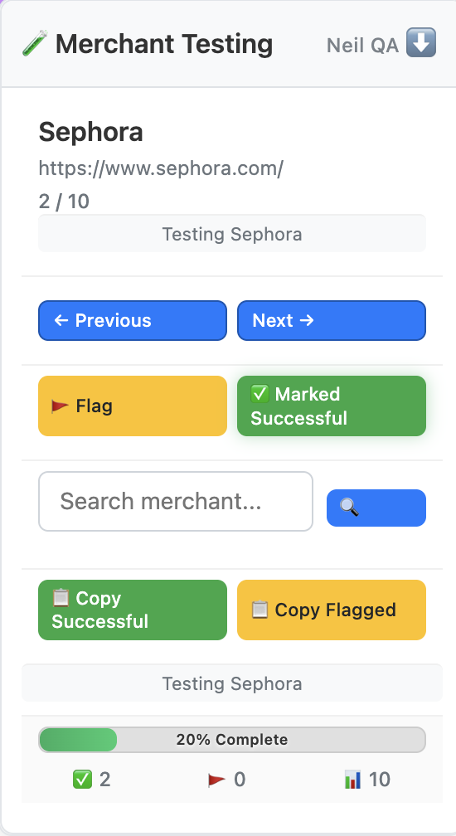
New Tools!

Slide 11
Merchant Testing
Improved merchant testing was a key process improvement area. This tool streamlines testing for specific merchant lists, eliminating the need to navigate multiple documents.
Notes:
Update merchant picture

Slide 12
Live Demo

Slide 13
Features of Merchant Tester
Streamlined Merchant Testing
Seamless Navigation: Easily copy and paste a list of merchants into the extension, moving from one to the next effortlessly.
Comprehensive Reporting: Download a table of all tested merchants, with a dedicated column for "flagged" or "successful" status.
Quick Search & Access: Utilize the floating crouton/validation results to search for and jump to any merchant within your list.

Slide 14

How was this tool made?
This tool was made using Cursor AI. Cursor is an AI Integrated Development Environment that allows you to chat with any specific AI model (Claude, GPT, Gemini) and help you build the program you’re looking to create.

Slide 15
To Everyone Who Helped Along The Way
Dan Markham
Scott Ritch
Andrew Jurgenson
Cade Youngquist
Matt Schmucker
DQ & MO for handling my massive spam in Operations Channel

Slide 16
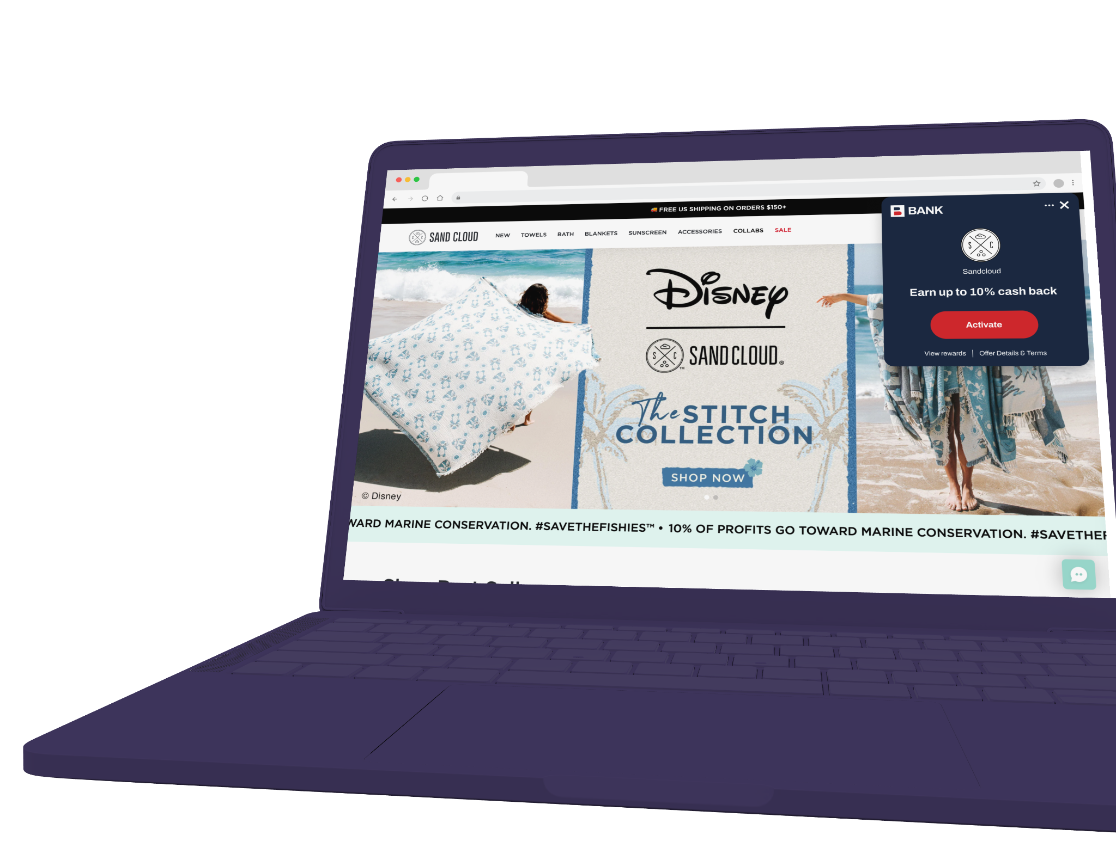
THANK YOU
Continue the conversation with neil.jones@wildfire-corp.com

